Slide 1

PHY2004: Electromagnetism and Optics
Lecture 10:
generalised Faraday’s
and Ampere’s law
Dr. Charlotte Palmer/Prof. Gianluca Sarri

Slide 2
Electrostatic and magnetostatic fields
Static fields are unchanging in time.
The time differential of an unchanging quantity is zero.
Electrostatic fields have divergence:
Enclosed charge
In differential form:
In integral form:
Charge density
Component of electric field normal to surface
Magnetostatic fields are solenoidal (divergence-free):
Component of magnetic field normal to surface
Dr. Charlotte Palmer/Prof. Gianluca Sarri

Slide 3
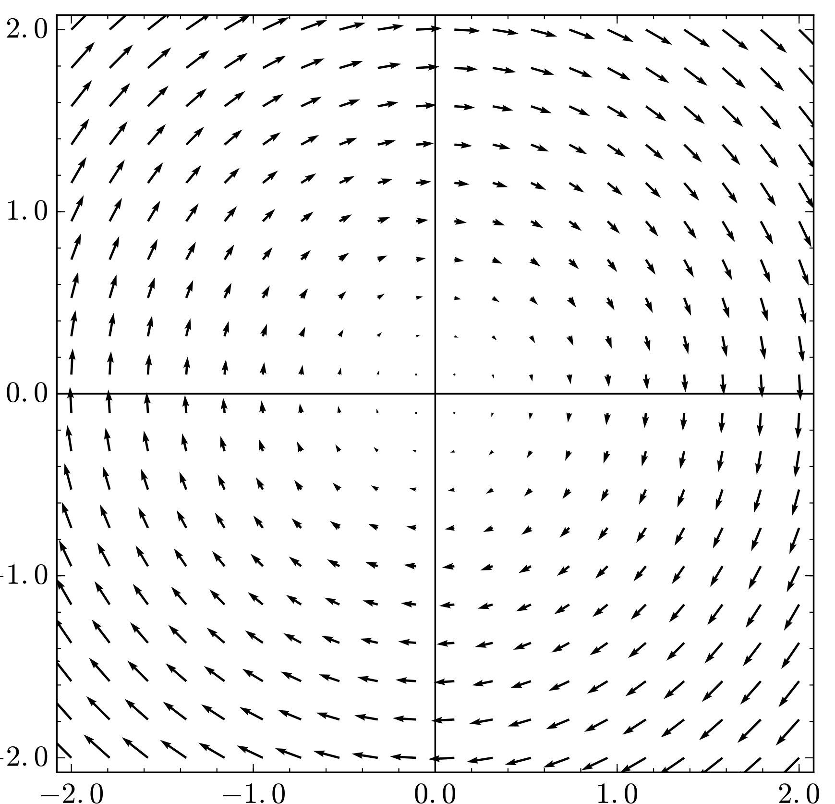
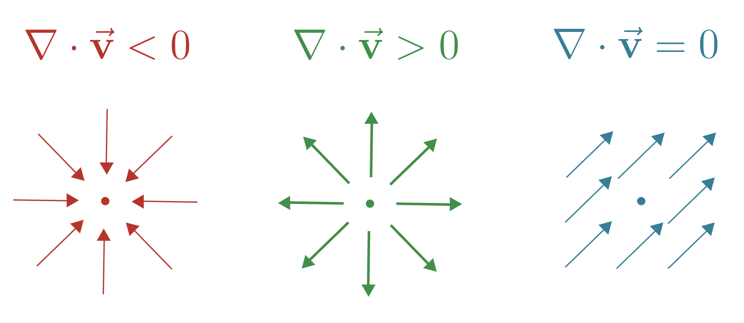
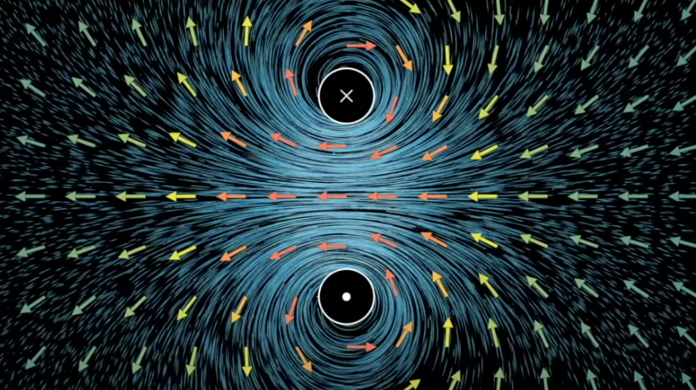
Reminder on divergence
Divergence is a property that we can calculate for vector fields measured at a point.
It represents the flow into and out from the point. If there is more flow out of a point we have positive divergence – “a source” (positive charge). Alternatively we have “a sink” (negative charge).
From Khan Academy: Divergence
From Wikipedia: Solenoidal vector field
If we have zero divergence everywhere then the fluid density is constant.
Just like magnetic field likes through a current loop.
Dr. Charlotte Palmer/Prof. Gianluca Sarri
From Youtube 3Blue1Brown: Divergence and Curl

Slide 4
Does it have divergence?
From Fleish – A student’s guide to Maxwell’s equations
Dr. Charlotte Palmer/Prof. Gianluca Sarri

Slide 5
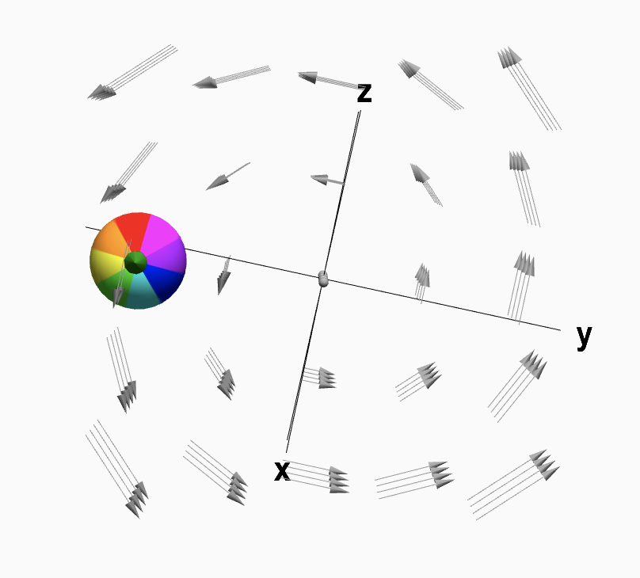
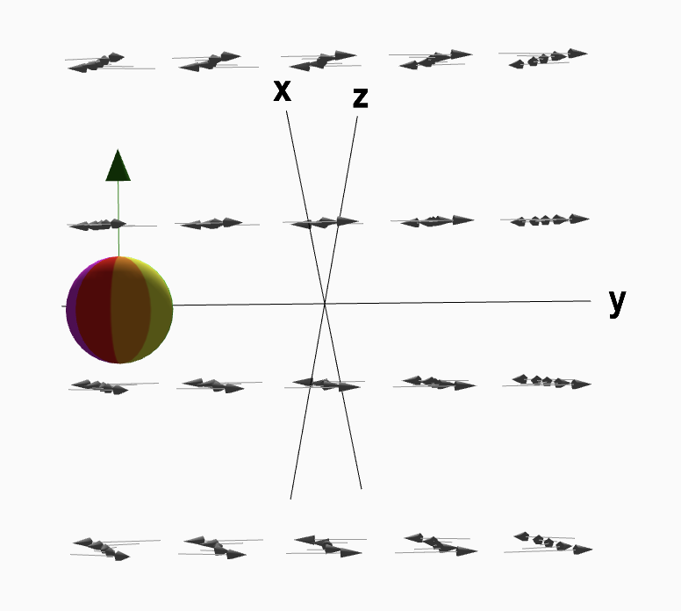
Reminder on curl
Curl is also calculated at a point and represents the circulation or rotation of the vector field.
It’s easy to picture macroscopic circulation but curl measures microscopic circulation. To imagine this picture a beach ball fixed in place in the field. If the beach ball rotates around its centre, curl is non-zero.
(Note: Often fields with macroscopic circulation also have curl)
Curl is a vector and has direction which you can work out.
From Math Insight: Curl Idea
Dr. Charlotte Palmer/Prof. Gianluca Sarri

Slide 6
Does it have curl?
From Fleish – A student’s guide to Maxwell’s equations
Dr. Charlotte Palmer/Prof. Gianluca Sarri

Slide 7
Faraday’s observations
Electrostatic fields are irrotational (curl-free):
This also makes them conservative
In integral form that reads:
Component of electric field parallel with contour
S
N
S
However, Faraday noticed that moving a
magnetic field into an electric circuit induced
an electric field such that
Φ
C
Dr. Charlotte Palmer/Prof. Gianluca Sarri

Slide 8
Time-varying flux of magnetic fields
The flux of magnetic field is defined as:
S
Surface integral
Unit surface normal
N
S
Φ
Magnetic flux
Component of magnetic field normal to surface
C
Magnetic field
We can calculate how the flux changes with time using the following equation.
Note: If the effective area or your loop is changing with time but the magnetic field is constant within the loop it can be easier to consider the rate of change of the area directly.
Dr. Charlotte Palmer/Prof. Gianluca Sarri

Slide 9
Time-varying flux of magnetic fields
How can we vary the magnetic flux:
a) changing field
b) changing surface area
c) changing surface orientation
B
B
B
dS
dS
dS
C
C
C
Reducing field strength
Decreasing field strength
Tilting the surface
B
B
dS
B
dS
dS
C
C
C
Dr. Charlotte Palmer/Prof. Gianluca Sarri

Slide 10
Electromotive force
We can relate this changing flux to the integral of our induced electric field along the loop.
S
Changing magnetic flux
Line integral
N
S
Φ
Component of electric field along contour
C
Unit surface normal
This line integral is also often called the electromotive force.
This is not really a force but a force per unit charge over a specified distance – this is work per unit charge.
Dr. Charlotte Palmer/Prof. Gianluca Sarri

Slide 11
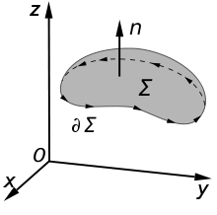
Lenz’s law: the important minus sign
For a changing magnetic flux through a surface, the induced electric field acts to oppose the change.
S
N
S
We can write:
Φ
C
Maxwell-Faraday law
(integral form)
Be careful with sign direction:
The direction of the surface normal and dl need to be chosen consistently to ensure the signs are correct.
Dr. Charlotte Palmer/Prof. Gianluca Sarri

Slide 12
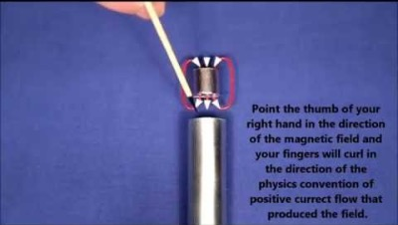
Lenz’s law: the important minus sign
For a changing magnetic flux through a surface, the induced electric field acts to oppose the change.
S
N
S
We can write:
Φ
C
Maxwell-Faraday law
(integral form)
From Youtube: Wayne Schmidt
Dr. Charlotte Palmer/Prof. Gianluca Sarri

Slide 13
Which direction is the induced Electric field?
Considering the changing flux situations from before?
a) changing field
b) changing surface area
c) changing surface orientation
B
B
B
dS
dS
dS
C
C
C
Reducing field strength
Decreasing field strength
Tilting the surface
B
B
dS
B
dS
dS
C
C
C
Dr. Charlotte Palmer/Prof. Gianluca Sarri

Slide 14
Which direction is the induced Electric field?
Considering the changing flux situations from before?
a) changing field
b) changing surface area
c) changing surface orientation
B
B
B
dS
dS
dS
C
C
C
Reducing field strength
Decreasing field strength
Tilting the surface
B
B
dS
B
dS
dS
C
C
C
Dr. Charlotte Palmer/Prof. Gianluca Sarri

Slide 15
Time-varying flux of magnetic fields
Maxwell-Faraday law
(integral form):
Kelvin-Stokes’ theorem:
The line integral of a vector field, F, over a loop is equal to the flux of its curl through the enclosed surface.
Use Kelvin-Stokes’ theorem to convert the line integral to the curl of the electric field:
From this we see the curl of the electric field is:
If the magnetic field is unchanging then the curl is zero.
Maxwell-Faraday law
(differential form):
Dr. Charlotte Palmer/Prof. Gianluca Sarri

Slide 16
Electric fields in terms of potentials
The magnetic field is defined in terms of a vector potential:
Substituting this in the new expression for the curl of E leads to:
Now, it is a mathematical identity that:
That implies that:
for time-independent magnetic fields, we retrieve the electrostatic form.
Curl is distributive
This is needed here because our gradient should point to the increasing field
Dr. Charlotte Palmer/Prof. Gianluca Sarri

Slide 17
Maxwell’s equation so far
with the material equations:
and the Lorentz force:
If time-varying B fields induce an electric field, can we also expect
the opposite (time-varying electric field inducing a magnetic field)?
In other words, should we also refine the equation: ?
Dr. Charlotte Palmer/Prof. Gianluca Sarri

Slide 18
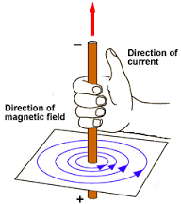
Ampere’s law
We have seen that, in magnetostatics:
Current density
If we take the divergence of this equation:
The left-hand side is identically zero (divergence of the curl of a vector is always zero, regardless of the vector).
So:
strictly implies:
Dr. Charlotte Palmer/Prof. Gianluca Sarri

Slide 19
Charge continuity
The divergence of J is related to the rate of change of the charge density via the charge continuity equation:
Reminder - charge continuity equation:
Charge is locally conserved:
Flux of current through the surface
Rate of change of charge density in volume
Gauss’ divergence theorem: The total sources of vector field, A, within a volume equals the flux through an enclosing surface.
While the charge continuity equation is generally applicable constant current density indicates this is valid ONLY for steady currents (magnetostatics)
Apply Gauss’ theorem to the LHS:
But what if the current isn’t constant, and the change in charge density isn’t zero?
So:
Dr. Charlotte Palmer/Prof. Gianluca Sarri

Slide 20
Charging capacitor
You’re familiar with capacitors which are common components of circuits. Here, we have current flowing into a break in the circuit.
If we have a constant input current we can use our magnetostatics to try to calculate the magnetic field.
Based on our previous work we draw the Amperian loop around the wire and the closed surface as a flat disk.
But Ampere’s law should give the same answer even if we choose a different surface enclosed by the same loop.
Here we can form lots of surfaces with no current
Amperian surface
I
Capacitor places
Dr. Charlotte Palmer/Prof. Gianluca Sarri

Slide 21
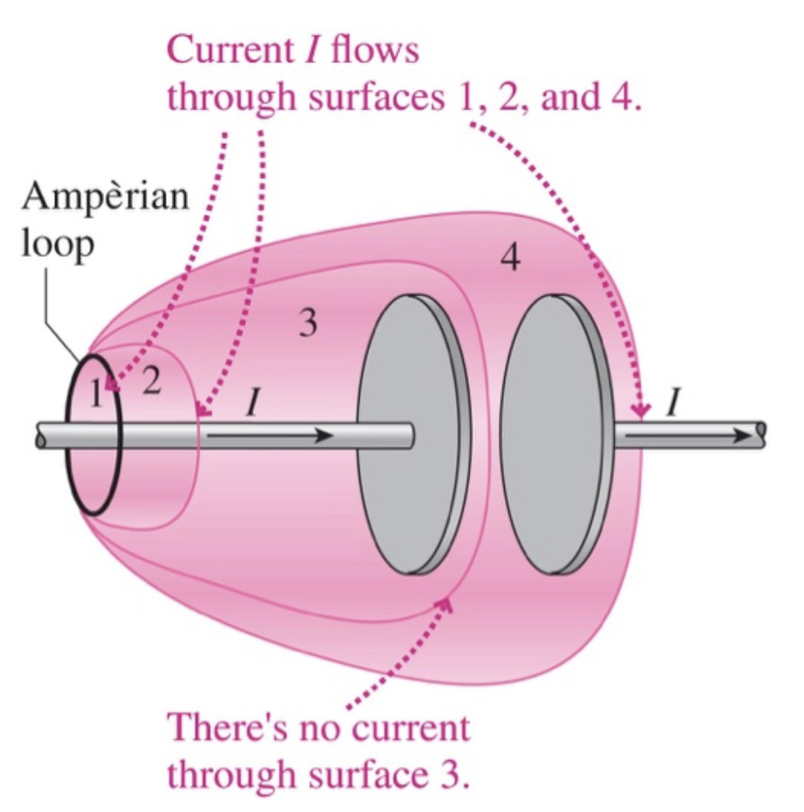
Charging capacitor
You’re familiar with capacitors which are common components of circuits. Here, we have current flowing into a break in the circuit.
If we have a constant input current we can use our magnetostatics to try to calculate the magnetic field
Based on our previous work we draw the Amperian loop around the wire and the closed surface as a flat disk.
But Ampere’s law should give the same answer even if we choose a different surface enclosed by the same loop.
Here we can form lots of surfaces with no current.
From Dr. C. L. Davis, Uni. Louisville
Dr. Charlotte Palmer/Prof. Gianluca Sarri

Slide 22
Displacement current
Starting with the continuity equation and Gauss’ law:
We can rearrange Gauss’ law to express the charge density in terms of the electric field.
And substitute this into the continuity equation in place of charge density.
Because the del operator is commutative, we can rewrite this as:
Dr. Charlotte Palmer/Prof. Gianluca Sarri

Slide 23
Displacement current
If we look back to Ampere’s law:
We can now generalise Ampere’s law to include both constant currents and changing charge density using our formulation of the charge continuity equation.
physical currents
Changing charge density
total “current”
We can think of these as two different currents:
J, which relates to physical currents in the system.
And rate of change of charge with time.
This second term is often confusingly called displacement current, J_{D}
Dr. Charlotte Palmer/Prof. Gianluca Sarri

Slide 24
Ampere’s law in vacuum and in material
Maxwell-Ampere law in a vacuum.
We can also express this in terms of H and D. If we start again in the material.
Displacement field, D, is determined using the density of ‘free charge’ or the charges that have made the volume not charge neutral.
Gauss’ law
Continuity equation
Bound charges responsible for polarization field
Dr. Charlotte Palmer/Prof. Gianluca Sarri

Slide 25
Ampere’s law in vacuum and in material
This time combining this with the general form of Ampere’s law with H.
free current
We find the generalized form of the Maxwell-Ampere law:
Generalised Maxwell-Ampere law
J_{f} is often called ‘free current’ as in currents due to the propagation of charges rather than magnetic dipole generated currents of bound electrons.
For a nice proof of this, read “Proof of equivalence” section of the Wikipedia entry on Ampere’s circuital law.
Dr. Charlotte Palmer/Prof. Gianluca Sarri

Slide 26
Full Maxwell’s equations – microscopic form
Microscopic form = including all charges
Integral form
Differential form
Relates fields in a region of space to fields on a boundary – useful for systems with symmetry
Calculating the local field at a point
Gauss’ law:
Faraday’s law:
Ampere’s law:
Dr. Charlotte Palmer/Prof. Gianluca Sarri

Slide 27
Relating microscopic and macroscopic forms
Microscopic form of Maxwell’s equations includes all charges/currents but we know that in materials this can get complicated.
The Macroscopic forms help us to deal with these situations where we may have contributions to total charge from bound charges.
In magnetic materials the bound currents, J_{b}, can act as a source of magnetic fields.
Magnetisation of the material
Changing polarization of the material also provides a source of current as this involves movement of charges (currents):
Total current is therefore:
Microscopic Ampere-Maxwell law is:
Derivation following from Fleisch
Dr. Charlotte Palmer/Prof. Gianluca Sarri

Slide 28
Relating microscopic and macroscopic forms
Sub in bound and polarization currents:
Gather terms:
Derivation following from Fleisch
Dr. Charlotte Palmer/Prof. Gianluca Sarri

Slide 29
Full Maxwell’s equations – macroscopic form
Macroscopic form = equations in matter/simplified for accommodating bound charge
Integral form
Differential form
Relates fields in a region of space to fields on a boundary – useful for systems with symmetry
Calculating the local field at a point
Gauss’ law:
free charge density
Faraday’s law:
Ampere’s law:
free current
Dr. Charlotte Palmer/Prof. Gianluca Sarri

Slide 30
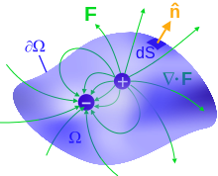
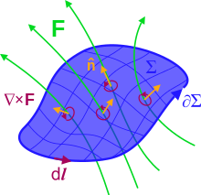
Relating integral and differential forms
Relating the integral and differential forms using:
Gauss’ divergence theorem:
The divergence of a vector field, F, within a volume, V, is equal to the total flux of that vector through an enclosed surface.
Kelvin-Stoke’s theorem:
The line integral of a vector field, F, over a loop is equal to the flux of its curl through the enclosed surface.
Note these apply to vector fields that are continuous and have continuous derivatives.
From Wikipedia – Maxwell’s equations
Dr. Charlotte Palmer/Prof. Gianluca Sarri

